Slide 1
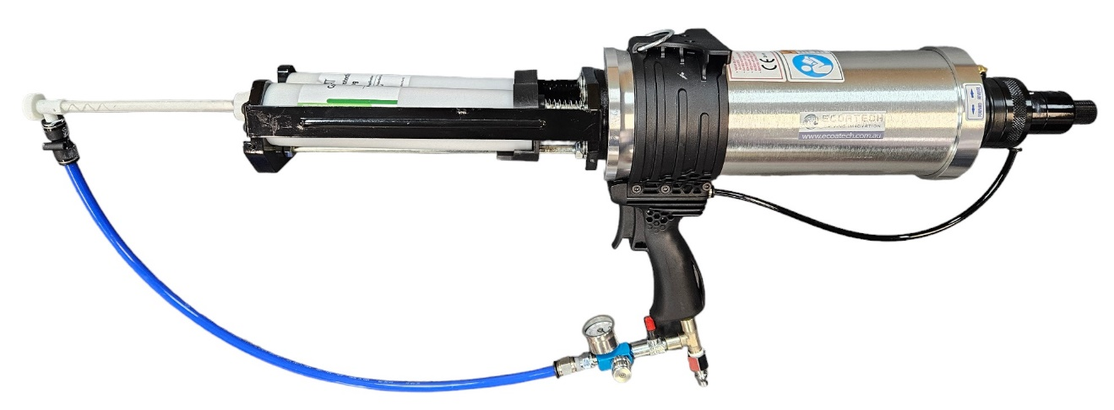
Cartridge Gun
EonCoat Cartridges are well suited for trials, confined spaces or small ongoing maintenance of assets. Cartridges are applied with a dual component spray system, by an EonCoat endorsed applicator.
Configuration
600ml (300ml of Part A and 300ml of Part B)
Each cartridge comes with 2x static mixers
Video Resource

